Slide 1
Airbnb in NYC

Slide 2
Beginning
Middle
Solution
End

Slide 3
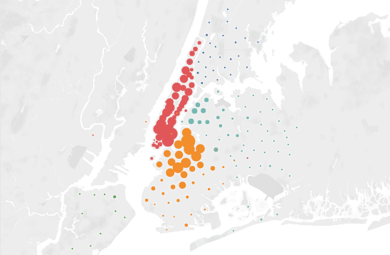
A new use for your properties in NYC
Explain MAP
Bronx
Brooklyn
Manhattan
Queens
Staten Island
<50
>1500
750

Slide 4
What is Airbnb?
Brief background history of Airbnb

Slide 5
Beginning
Middle
Solution
End

Slide 6
Why Airbnb in NYC instead of normal renting?
Reasons why airbnb might be better than renting

Slide 7
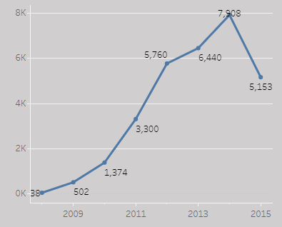
Can you trust in Airbnb?
Count of new properties
We see strong proyectiong for the future. Current decline due to lack off data for the entire year.
Score Average
Reviews Count
93
90,006

Slide 8
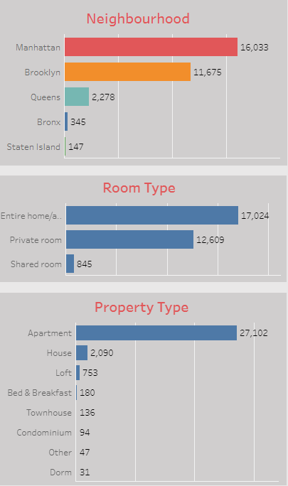
Airbnb likes all kinds of properties
Price Average
$164

Slide 9
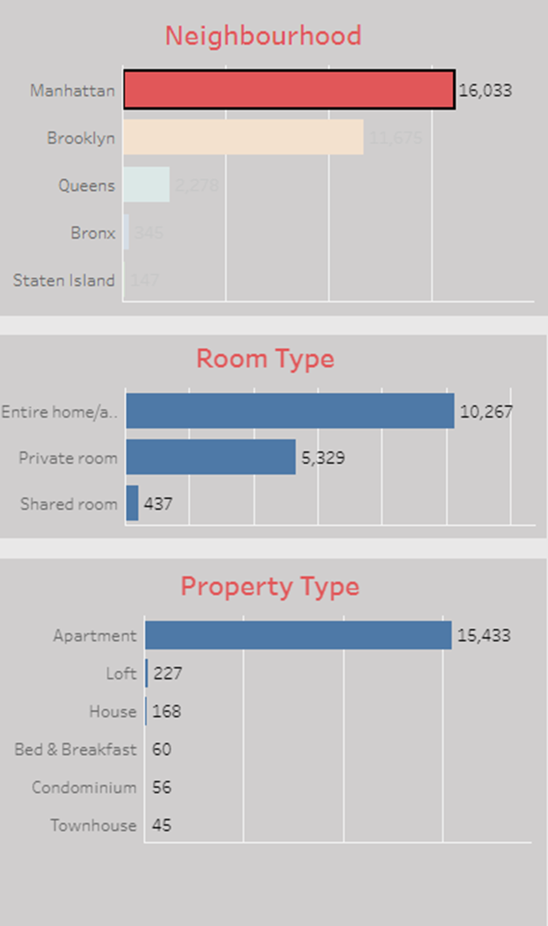
Business opportunities for everyone
Price Average
$197

Slide 10
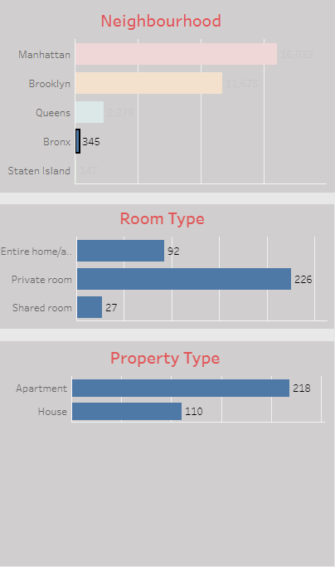
Business opportunities for everyone
Price Average
$214

Slide 11
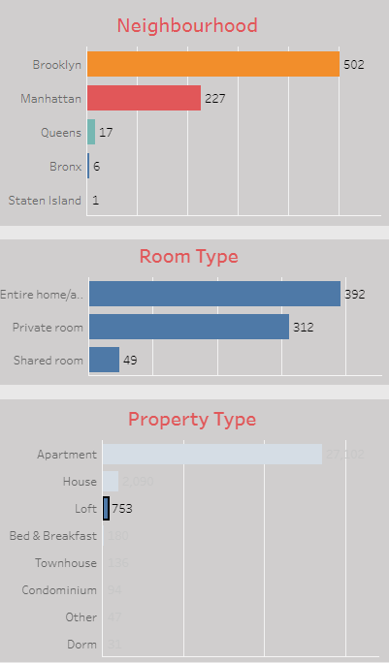
Business opportunities for everyone
Price Average
$262

Slide 12
Beginning
Middle
Solution
End

Slide 13
Resolution
Answer to real pilot user questions (biweekly 2).

Slide 14
Beginning
Middle
Solution
End

Slide 15
Endgame
Show dashboard
Summary of key points with dashboard
Address any other audience questions with dashboard.

